Slide 1
How can developing Kinaesthetic Empathy enable a sustainable collaborative approach for new groups working together in Theatre Making?
Action Research Project Cat Busk
Notes:
Hello and welcome to my mini action research project, asking the question: How can Developing Kinaesthetic empathy enable a sustainable collaborative approach for new groups working together in theatre Making.
I am a college admissions tutor and associate lecturer, at WCA, as well as a registered dance movement psychotherapist, choreographer and movement director, and Kineasthetic Enpathy is central to my practice.

Slide 2
Kinaesthetic Empathy in a nut shell
Kinesthetic empathy is the experience of “placing ourselves ‘inside’ another’s kinesthetic experience” (Artpradid, 2023,p.1).
The ability to feel and resonate emotionally and sensorially on the level of the body (with or without words).
Used in theatre-making, movement direction, intimacy and consent training, and creative arts therapies. Kinaesthetic Empathy enables performers and audiences to physically and emotionally resonate with movement., creating a shared embodied experience and non-verbal communication (Reynolds & Reason, 2012).
Notes:
Used in theatre-making, movement direction, intimacy and consent training, and creative arts therapies Kinaesthetic Empathy enables performers and audiences to physically and emotionally resonate with movement., creating a shared embodied experience and non-verbal communication (Reynolds & Reason, 2012).

Slide 3
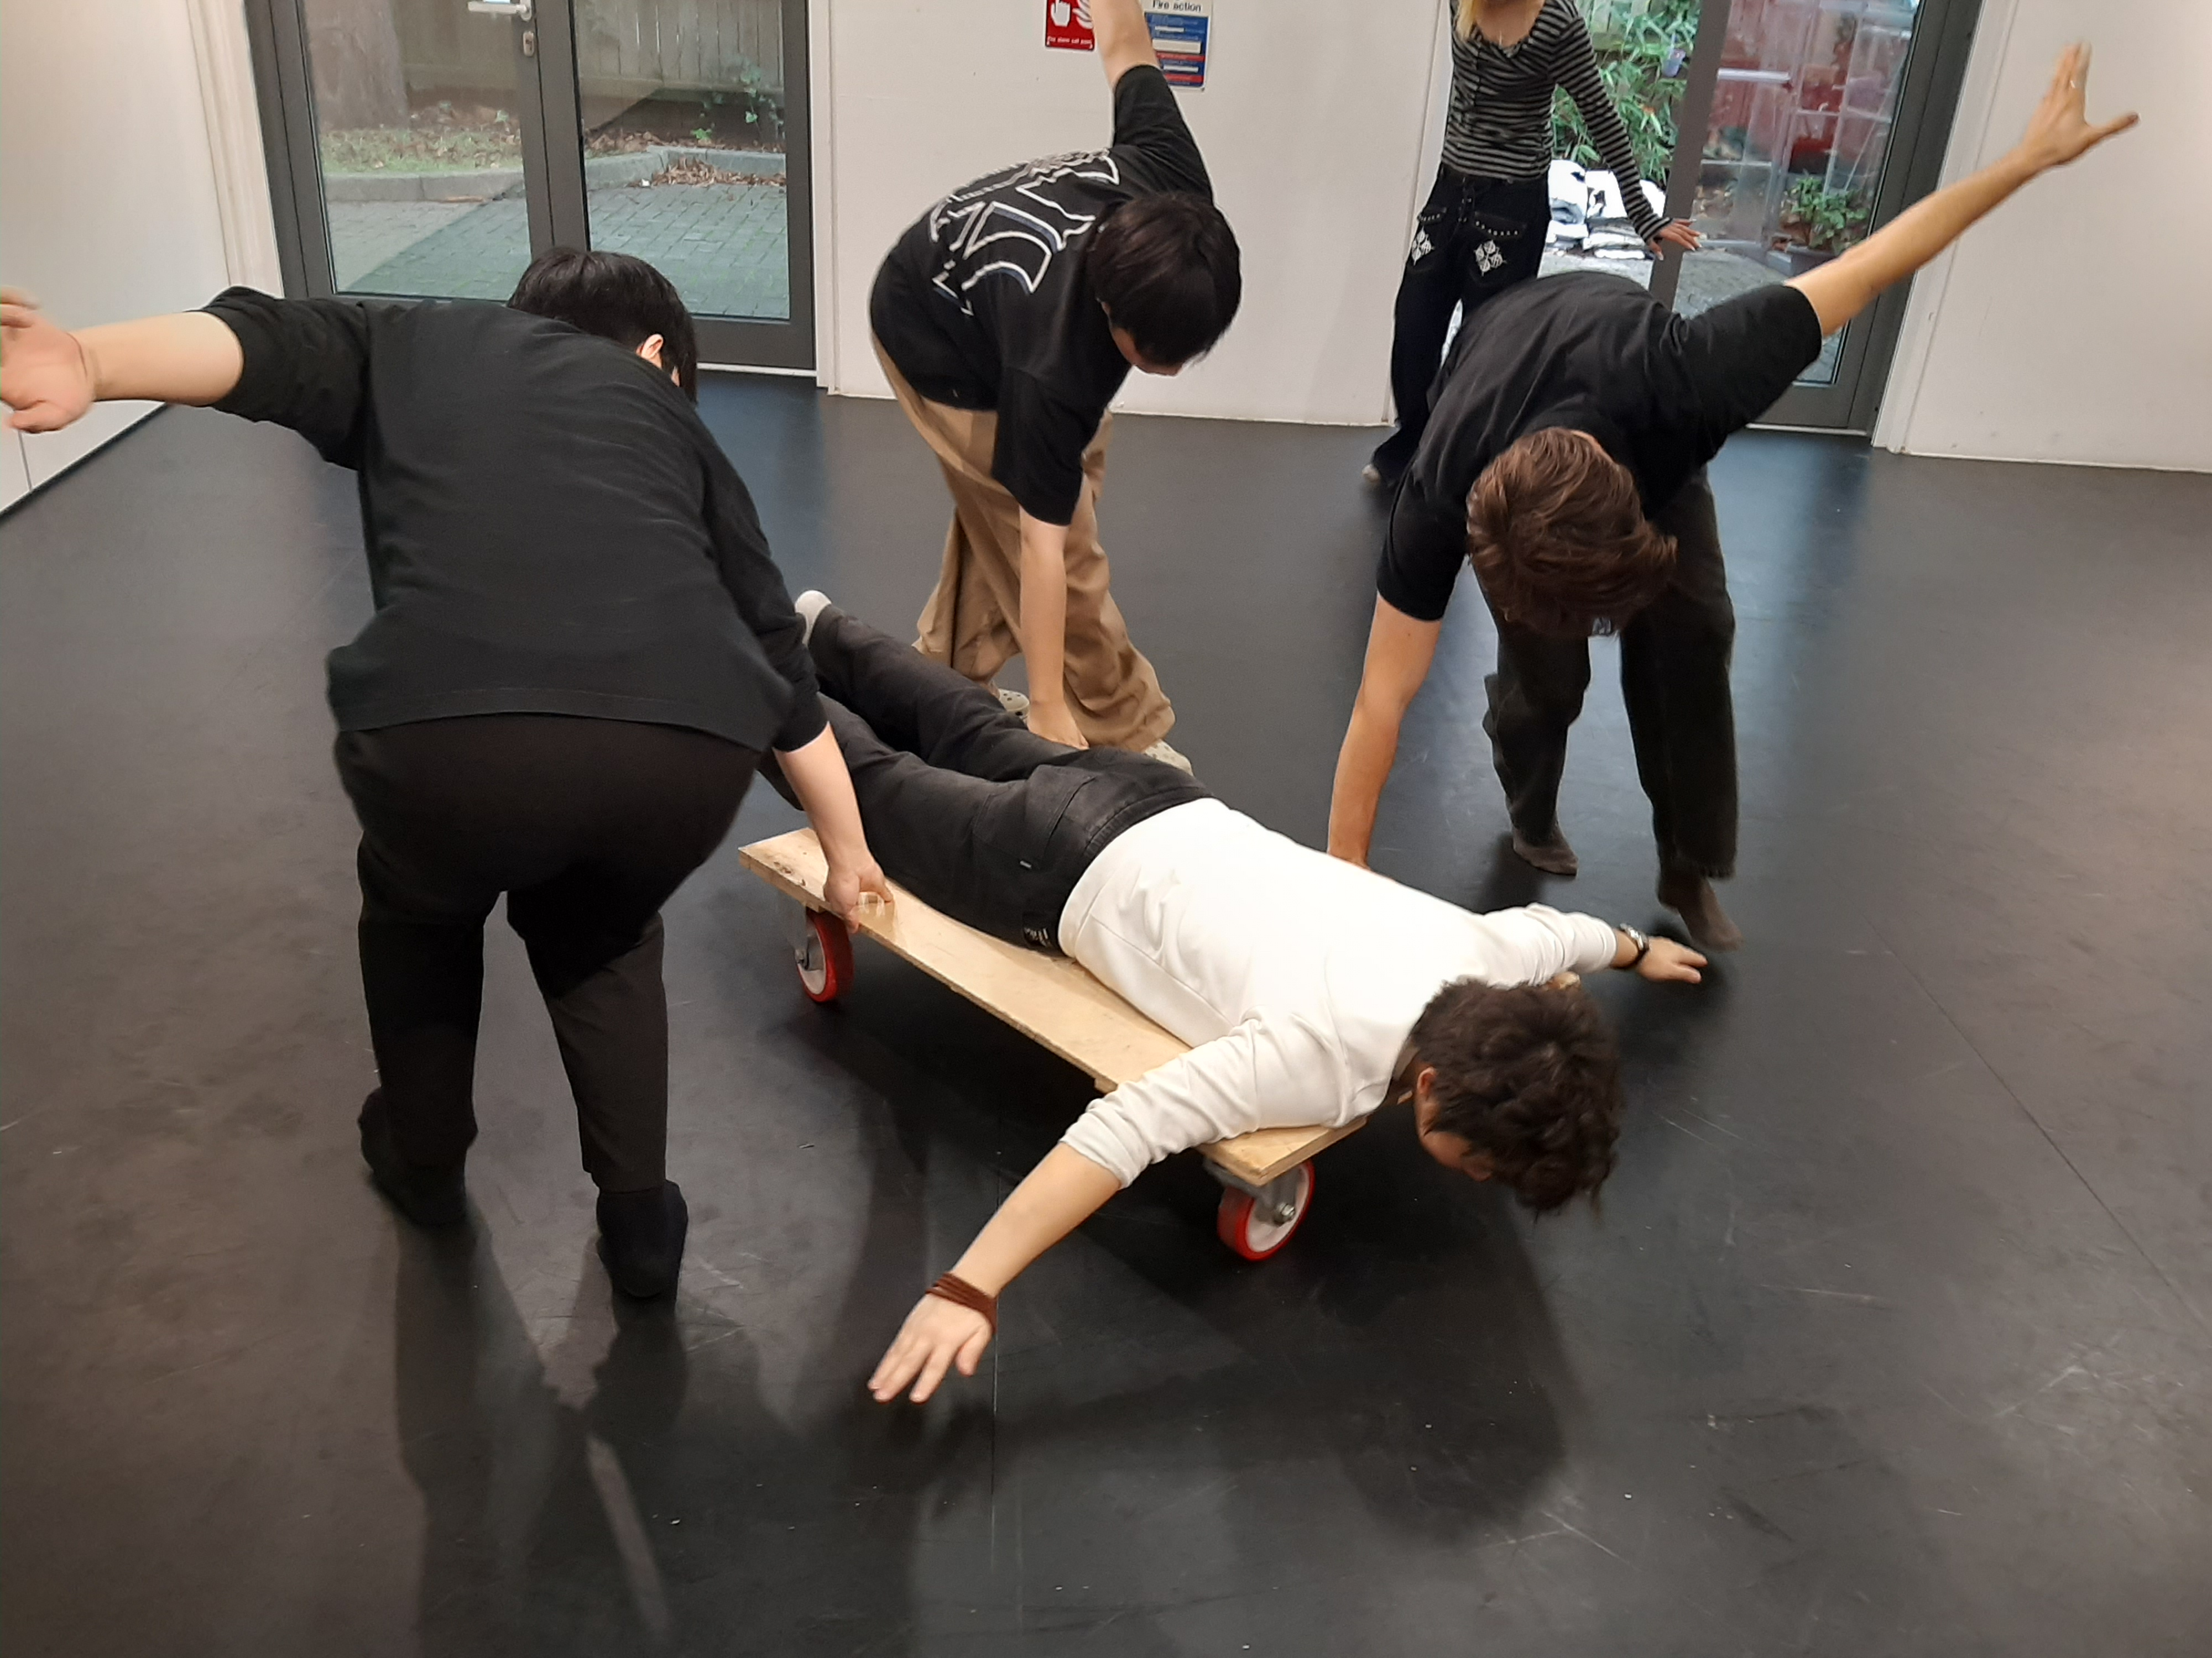
The project
Series of 3 workshops with newly enrolled students on an MA students on a Performance.
1 semi structured interview.
Notes:
The project was a series of three workshops, 1 in Oct, Nov & dec respectively, with newly enrolled students on the MA, who were all overseas students. 5 from Mainland china, and one from Europe. All with varying professional experience and practice within theatre making ( should know I interviewed and reviewed their applications). The workshops sat outside of their curriculum and were not embedded in any unit, but were called for from the course leader with the intention of helping the group come together by way of induction.

Slide 4
Rationalle
Student survey
Preference to work solo v’s course content being collaborative.
Lack of group cohesion & community.
Supporting non verbal modes of communication, and non verbal approaches to theatre making.
Working with kinesthetic empathy also has the possibility to activate embodied connections with others which, “breakdown monolithic identities by raising awareness of differences within the self ” (pg 320, Parekh-Gaihede’ 2012).
Notes:
student survey highlighted two points that students found difficult when working together: overcoming language barriers between them, as well as the varying levels of experience in the field.
This has led to students preferring to work on solo pieces rather than work in an ensemble. However, the course content requires, at times, that students work collaboratively.
PG community is small and has expressed a feeling of isolation and not part of the wider academic community at Wimbledon.
For this course in particular, low numbers of home students, and high numbers of overseas students ( a ratio of 1:10)* mean that students have a varying level of English as a second language which can cause a lack of cohesion in cohorts particularly when working within the verbal realm.
Working with nonverbal communication is important to the subject, as not all theatre making needs to be on a verbal level. (before we communicate though words, we communicate through the body.
Theatre has the potential to explore empathy across differences in culture and experience.

Slide 5
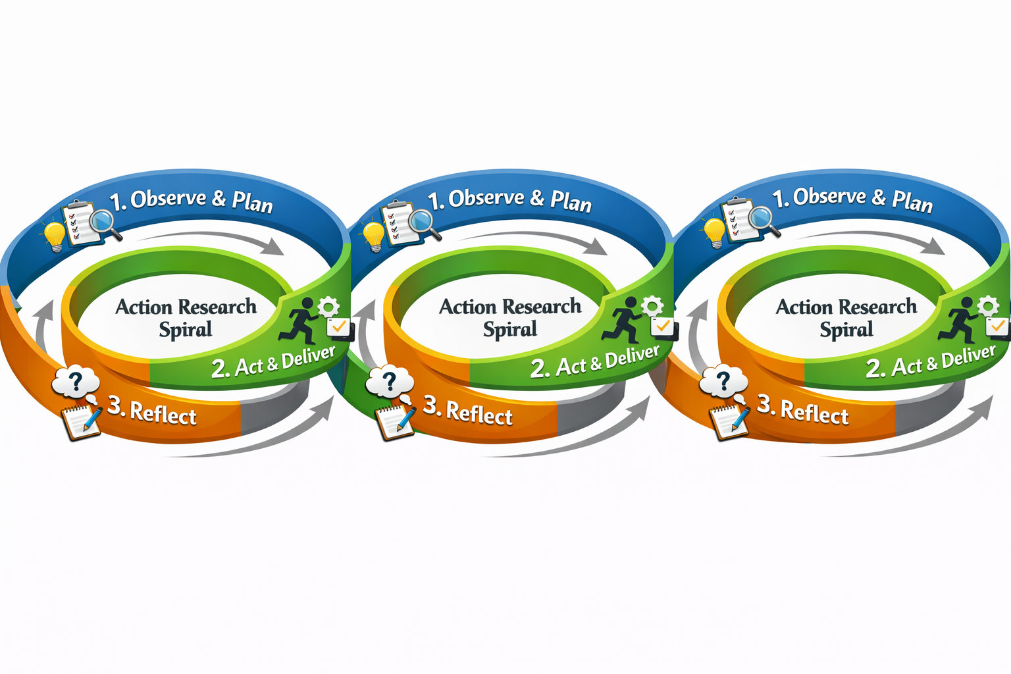
Research Methods
Iterative & Qualitative
Semi structured Interview (to gain more context surrounding the students and the course)
Creative Research Methods:
Auto Ethnographical
Peer interviewing (in real time)
Open space dialogue (Heron & Reason, 2001)
(Kolb, D.A.,1984, Ellis B 2006, Kara, 2015)
Notes:
The project is iterative and so follows the spiral you can see. More or less what I imagine in the middle of each spiral is the workshop, and the interview happened between the 2nd and third workshop.
Creative research, (as well as practice based research)
experiential learning (meaning I am continually asking the participants to reflect upon their lived experiences as well as invite embodied reflections ) and the feedback gathered from the students is auto ethnograpical, as it is coming from their lived experience. The open space dialogue is an approach I use in reflections between activities as well as check out methods, where, ideally it is a n open space with non judgement to the reflections that arise, as well a non bhierarquical approach.

Slide 6
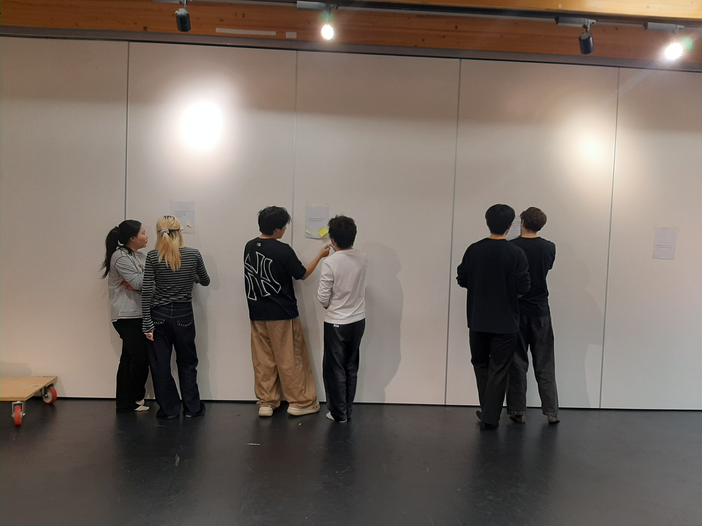
Project findings
Thematic reflexive analysis approach (Braun and Clarke. 2021, &, Kara, H. 2015),
Interview:
Space
Group Cohesion
Time
Skills
Notes:
I have analysed data following a thematic reflexive analysis approach (Braun and Clarke. 2021, &, Kara, H. 2015), -looking for patterns of meaning or themes across the data (semi structured interview and student feedback) to address my research question. Reflective Thematic Analysis is considered to be interpretive, created and situated, and therefore speaks to the nature of the project being experiential. More specifically, I am following a “more latent way” meaning that my “coding and theme development report concepts and assumptions underpinning the overt content of the data” (https://www.thematicanalysis.net/understanding-ta/).
Space: A lack of dedicated space that students could truly inhabit and shape, limiting their ability to immerse themselves in the work as a cohesive company or within a theatre-making residency model.
Group cohesion: Challenges emerged due to uneven levels of professional experience, dominant voices, and differing cultural norms, which at times inhibited equitable participation and made it difficult for some students to find their place within the group.
Time: Insufficient time to cultivate a collaborative environment or build shared experiences beyond the rehearsal space.
Skills: Limited time to both deliver the curriculum and support skill development for less-experienced students, particularly in foundational practices such as play, voice, and movement.

Slide 7
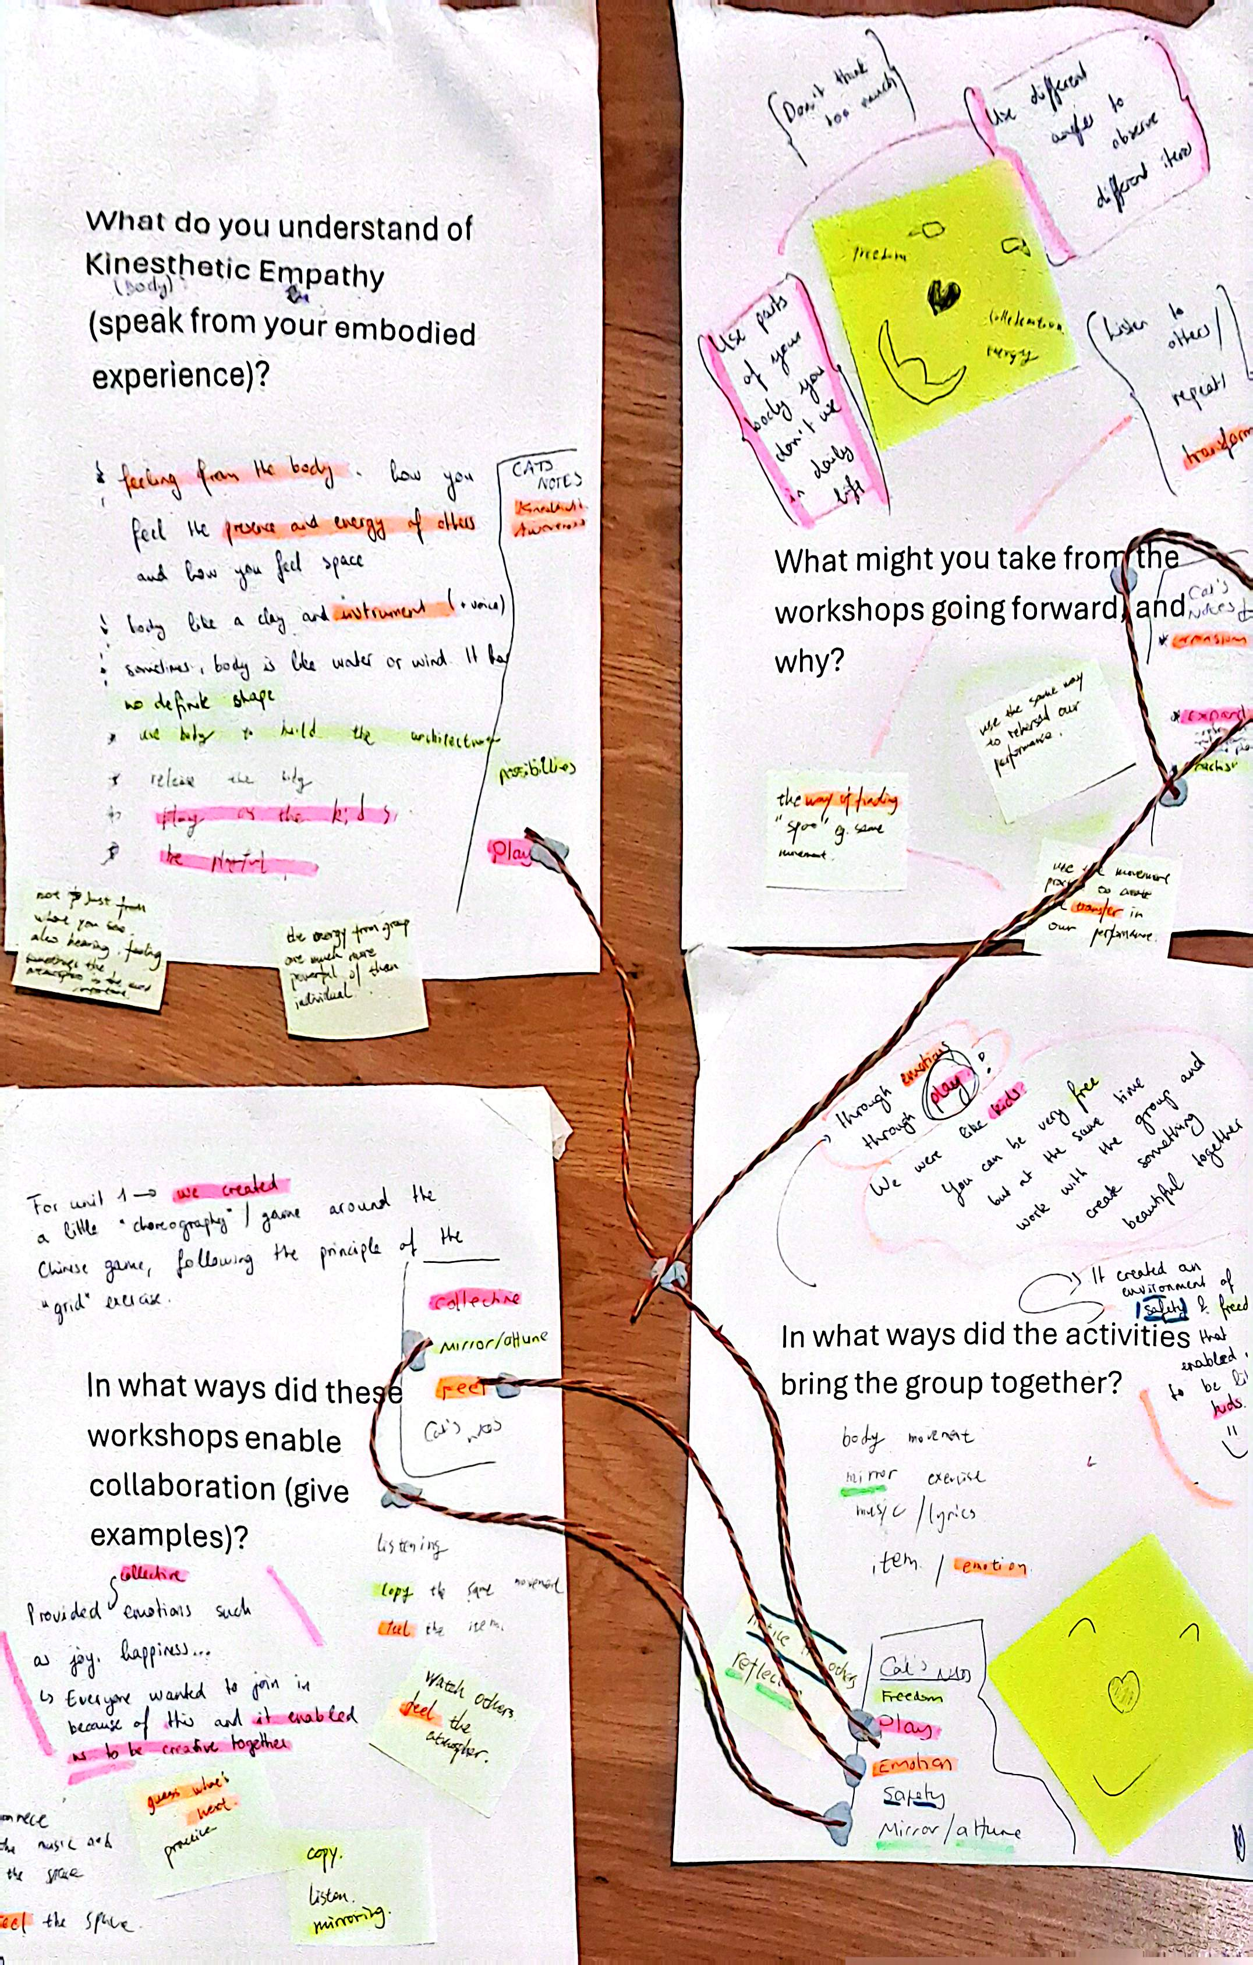
Project findings
“You can be very Free but at the same time work with the group and create something beautiful together” (Student Voice)
“It created an environment of Safety and freedom” (Student Voice)
Play
Feeling
Mirroring
Notes:
In general, the students described a sense of feeling more of a group as the workshops went on, as well as one student noting more specifically, moments when the group attuned and listened to one another, and when the group were less cohesive –and more individualistic. This reflection shows that a sufficient level of attunement was reached to be able to differentiate when the group moved cohesively or not, which suggests a high level of kinesthetic empathy was reached.
Themes that emerged from the students' reflections were:
Play: The experience encouraged students to return to play and creative exploration. One described play as a form of research, allowing them to “use different angles [physically] to observe” (student Voice) and break habitual bodily patterns, while others described feeling more connected to peers during play. I link this sense of connection to Spolin’s age-old notion of play being democratic participation, as students explored and “researched” with their bodies regardless of differences in theatre-making skills.
Feeling: Sensing the other, “listening to the other without just listening but by responding to them”. These reflections point towards empathy by being aware of their emotional state, as well as that of the other.
Mirror: Students frequently reflected on mirroring and attuning to others. While they did not explicitly link this to non-hierarchical practice, the process of responding in real time to another’s improvised movement inherently gives space, voice, and presence to the other, fostering collaborative, non-hierarchical approaches to theatre-making (Bogart & Landau, 2005).
These three themes align with the course leader’s interview, indicating that across the workshops, space was created for a non-hierarchical way of working despite differing levels of experience. The group developed sufficient cohesion to feel safe, enabling students to attune to one another and engage in playful, collaborative exploration

Slide 8
Conclusions
How can developing Kinaesthetic Empathy enable a sustainable collaborative approach for new groups working together in Theatre Making?
By developing skills of mirroring, attunement, and play, students can kinesthetically sense and emotionally connect with one another, fostering an empathetic and cohesive collaborative ensemble process. For this to be sustainable, there needs to be space and time within the curriculum, for students to build upon existing skills and nurture non-hierarchical modes of working as an ensemble.

Slide 9
critique
A struggle to ask the right questions:
Lack of quantitative evidence: There is an inherent difficulty in quantifying the subjectivity of non-verbal, embodied processes (Koch, 2020)
Professional Interpretation:
Semi structured Interview: “romantic” or emotionalist approach, revealing authentic inner perspectives but failing to generate more objective data (Alvesson, 2012)
Student feedback: Lack of critique & unacknowledged power dynamics? (Alvesson, 2012)

Slide 10
Bibliography
Alvesson, M. (2012) ‘Views on interviews: A skeptical review’, in Interpreting Interviews. London: SAGE Publications Ltd, pp. 9–42.Artpradid,
Ellis, C.S. and Bochner, A.P. (2006) ‘Analyzing analytic autoethnography: An autopsy’, Journal of Contemporary Ethnography, 35(4), pp. 429–449. https://doi.org/10.1177/0891241606286979 Heron & Reason, 2001
Kara, H. (2015) Creative research methods in the social sciences: A practical guide. Bristol: Policy Press. Koch, 2020
Kolb, D.A. (1984) Experiential learning: Experience as the source of learning and development. Englewood Cliffs, NJ: Prentice Hall.
Parekh-Gaihede, R. (2012) ‘Breaking the Distance: Empathy and Ethical Awareness in Performance’. In: Reynolds, D. and Reason, M. (eds.) Kinesthetic Empathy in Creative and Cultural Practices. Bristol, UK: Intellect Ltd, pp. 177–192.

